Slide 2

Matthew 13:24-30

Slide 3
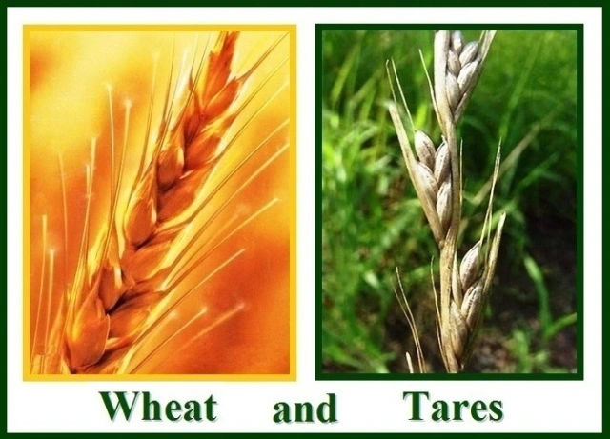
PARABLE OF THE TARES
Mixing of The Good And Bad
“The Bearded darnel” resembles wheat
Separation of Good From Bad – bad discarded and burned

Slide 4
EXPLANATION AND APPLICATION
Matthew 13:36-43
V.38 “the field is the world…”
Matthew 28:18 “in heaven and earth”
ALL of the earth SHOULD be subject to Him!
“Good seeds” – “the sons of the kingdom”
“Tares” – “the sons of the wicked one”
Common Misapplication – Discipline In The Church
Matthew 18:15-17; Romans 16:17; 1 Corinthians 5; 2 Thessalonians 3:6,14; Romans 6:16-18

Slide 5
THE PARABLE OF THE DRAGNET
Matthew 13:47-50
Net cast into sea
Good and bad fish in same net
Net NOT pulled up until END OF THE AGE!
Final Separation Will Take Place!

Slide 6
SEPARATION OF GOD’S PEOPLE
Primarily spiritual not physical – Matthew 5:45
We live IN the WORLD – 1 Corinthians 5:10
At Harvest God Will gather ALL MEN and Separate good from bad - Matthew 25:31-33
Time for repentance runs out – Matthew 25:34-46

Slide 7
INTERMINGING OF SAINTS AND UNFORGIVEN GOOD WHEN SAINTS REALIZE THEIR DUTY
Matthew 5:13-16 “light” “salt”
“Why Do The Wicked Prosper?” Job 21:7; Psalm 73:1-6; Jeremiah 12:1
2 Peter 3:9 “not willing that any should perish but that all should come to repentance”
Romans 2:4 “do you despise the riches of His goodness, forbearance, and longsuffering, not knowing the goodness of God leads you to repentance?”

Slide 8
THE SUMMARY:
The Wheat Grows With The Tares
The good fish are gathered with the bad
THEY WILL BE DIVIDED IN THE LAST DAY!

